Slide 1
Design & Optimization of Programmable Motion Profiling & Control With Autonomous UAV Applications
Wenjie Yu
Advisor: Jinjun Xiong

Slide 2
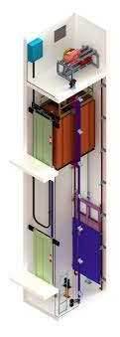
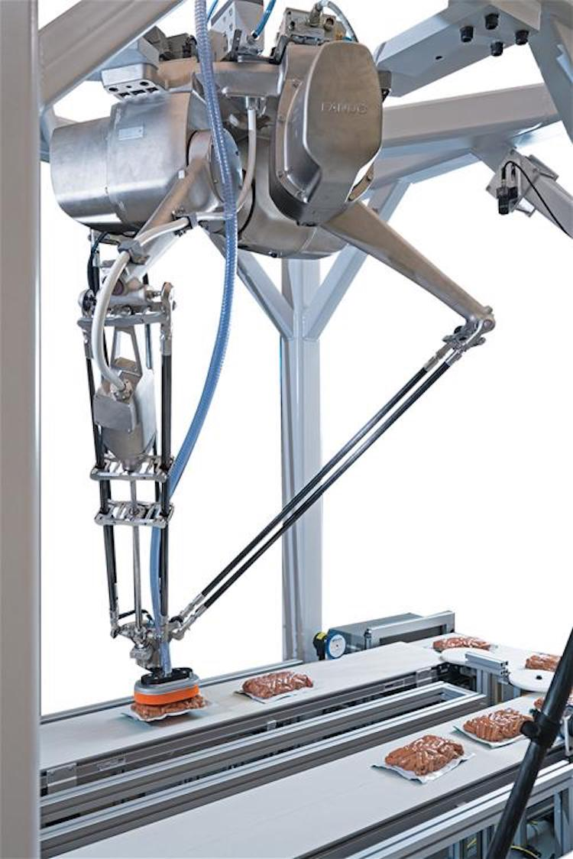
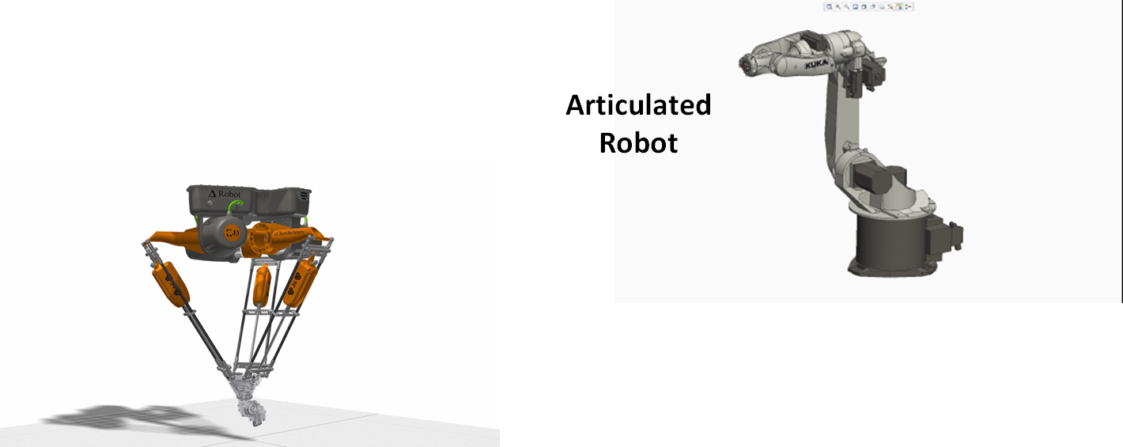
Motion Profiles and Controllers in the Industry
Often NOT Reusable
specific to a tool type
Not much programmability
few to none changeable parameters
Closed Source
source code not accessible
Expensive
hard to redesign, often requires a replacement of the entire controller

Slide 3
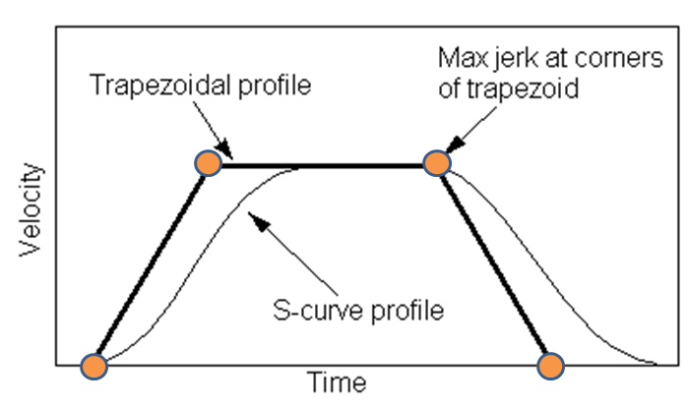
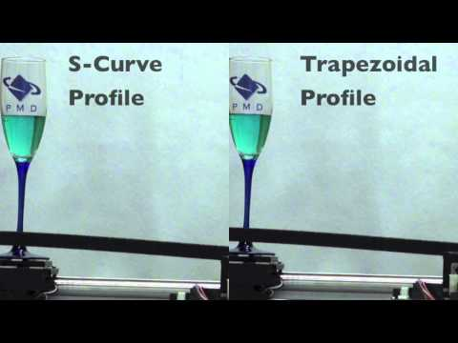
Trapezoidal Profile vs. S-curve Profile
Increase the smoothness of motion by eliminating sharp corners in the trapezoidal velocity curve
Eliminate residual vibration caused by infinite jerk at sharp corners
Generate higher-order profiles gives us more precise control of the smoothness of motion

Slide 4
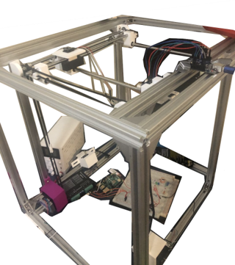
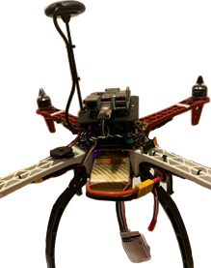
Research Objectives and Goals
Motion Profiling Feedforward System
Robustness
Programmability
Portability
Closed-loop Applications with Open-Sourced PID
Multi-Dimension translating platform
Drone Application with Ardupilot
Notes:
Stable to use with low expense for different applications
Allow user to customize “smoothness” of motion with as many options as possible Provide generic interfaces that encapsulates technical details

Slide 5
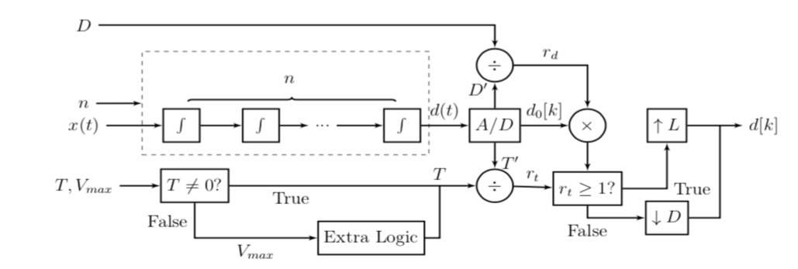
Feedforward System Overview
Allow users to pick the order n, i.e, the number of integrators
Allow users to set the most generic parameters
Total distance + total time
Total distance + maximum velocity
Provide a profile generation mechanism for signal x(t)
Allow users to pick the waveform, e.g. sine wave vs square wave
Hide the customization details from users
all the boundary conditions of piecewise

Slide 6
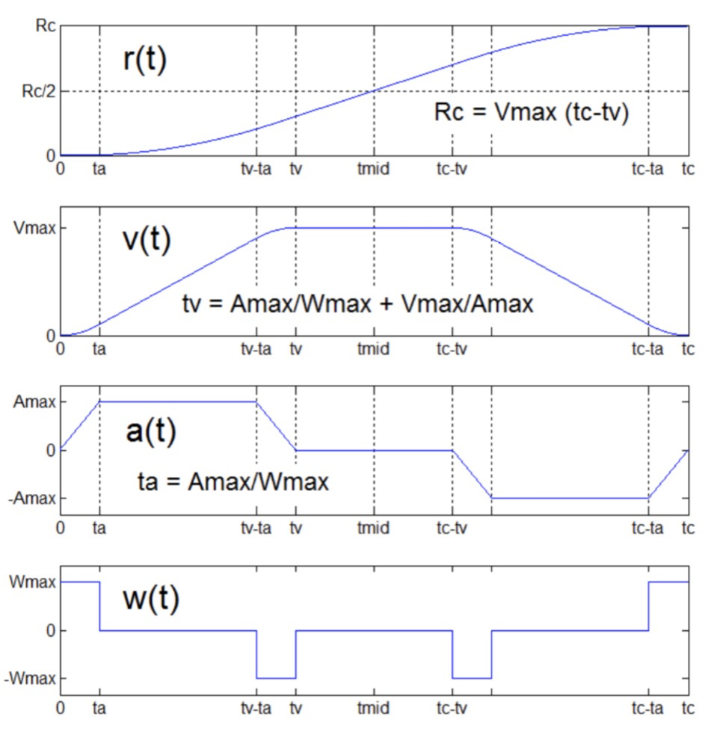
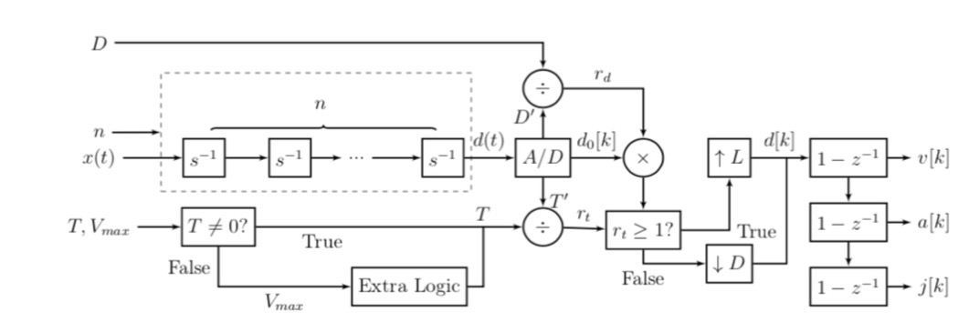
Extension of Traditional Motion Profiling Approach
Derive the formulas of all the piecewise functions with the user given order n (via integration)
Advantageous for a specific closed-source application
Limited Programmability
Runtime & memory Issue as n increases

Slide 7
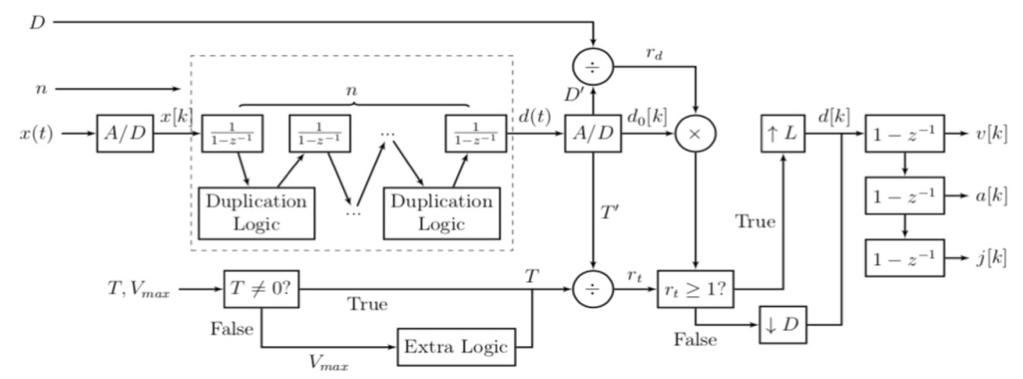
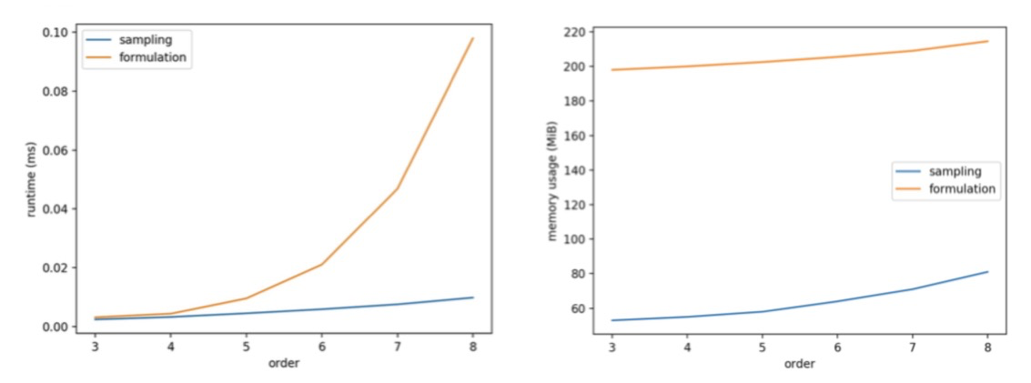
Digital Feedforward System
Sample only first 3 intervals of the highest order profile
Use Digital Integrators and recursive pattern
Other Advantages
Little to none storage requirement
No additional runtime caused by reading and saving overheads
No extra MACs done
O(2^{n}n³) vs O(2^{n})

Slide 8
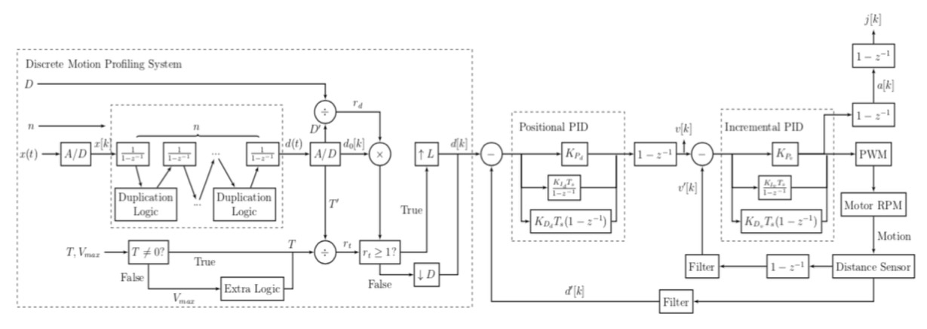
Closed Loop System

Slide 9
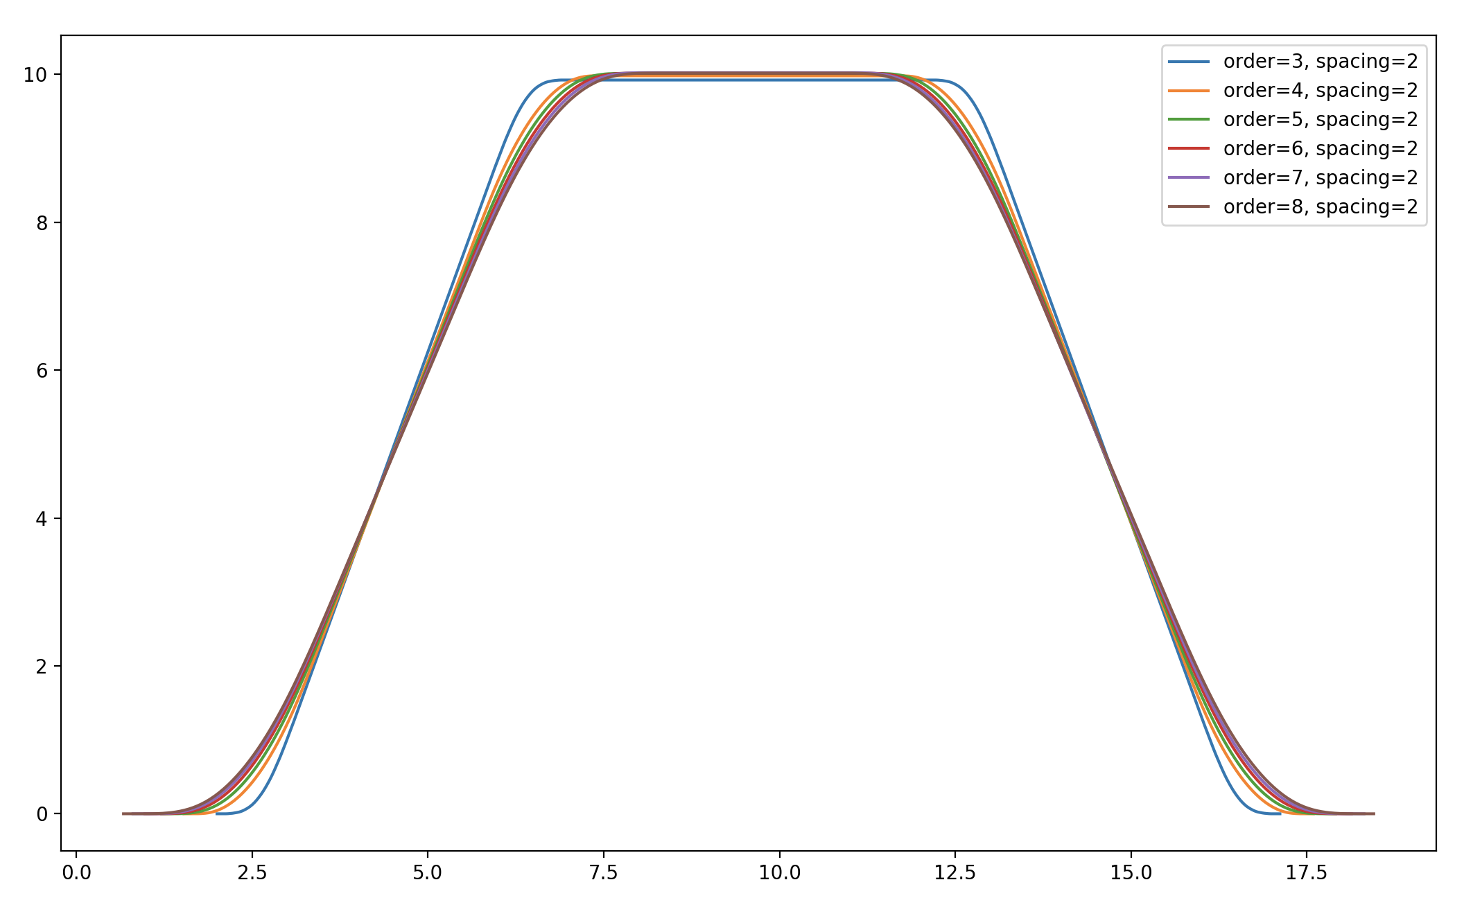
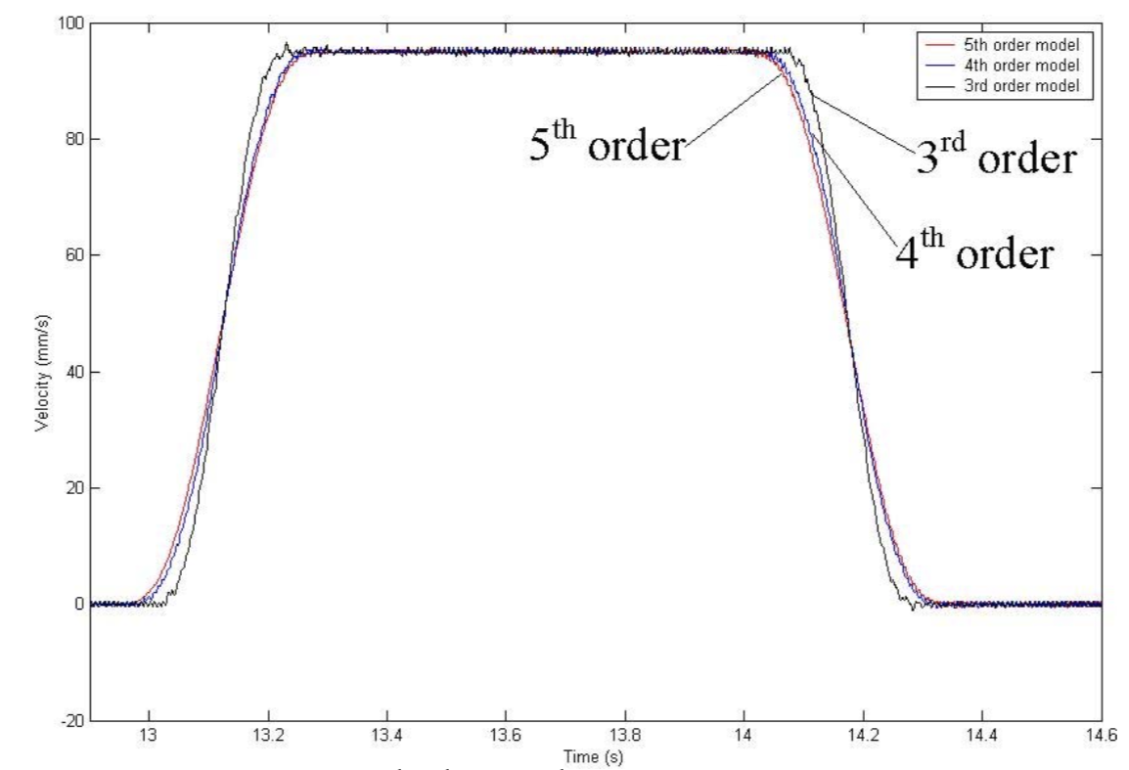
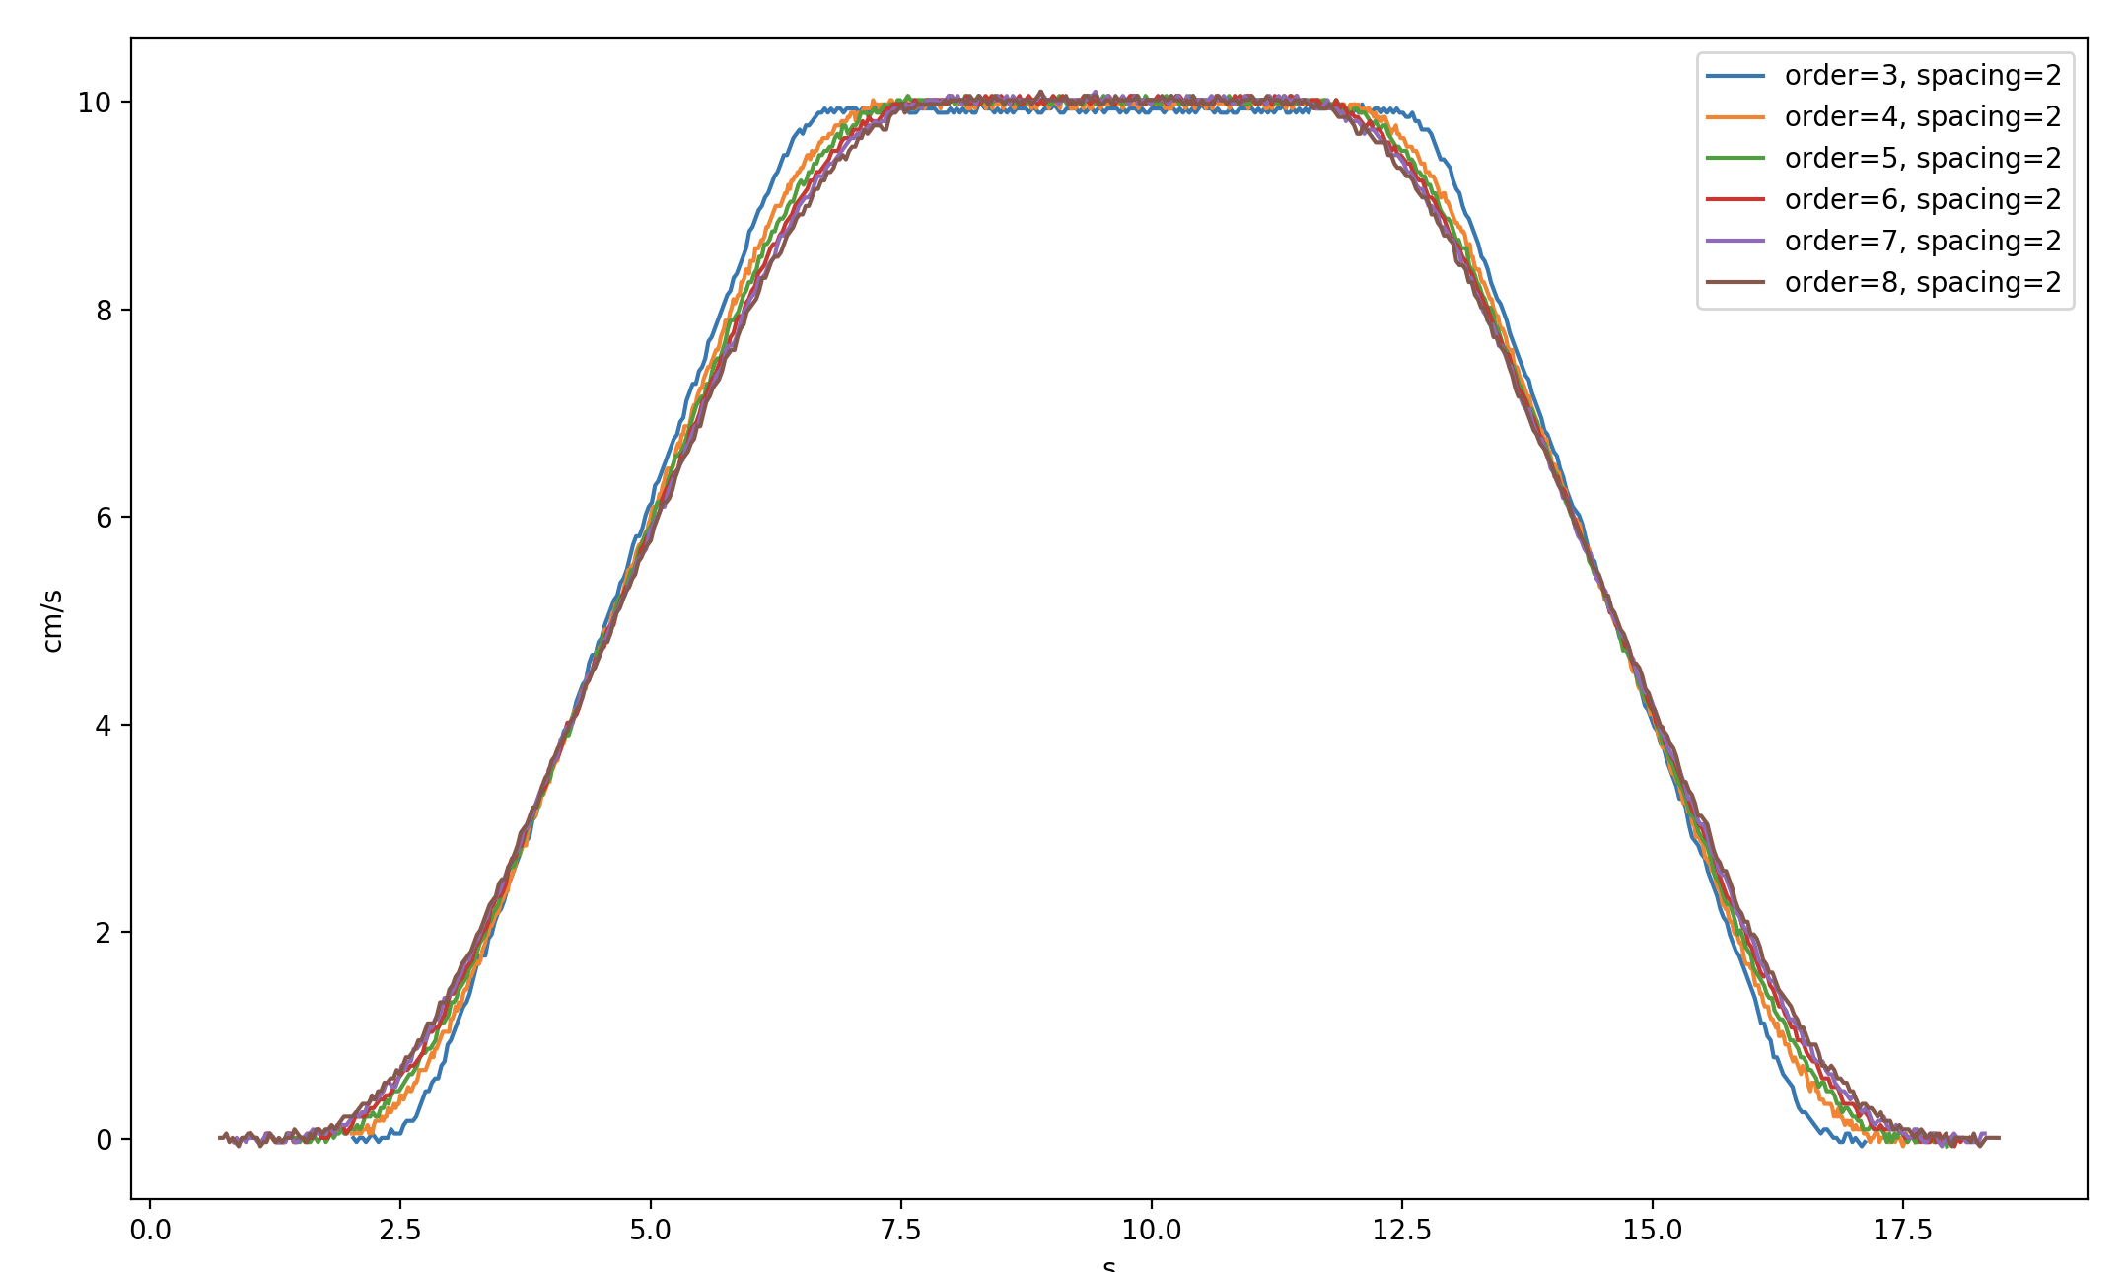
Comparison of Results

Slide 10
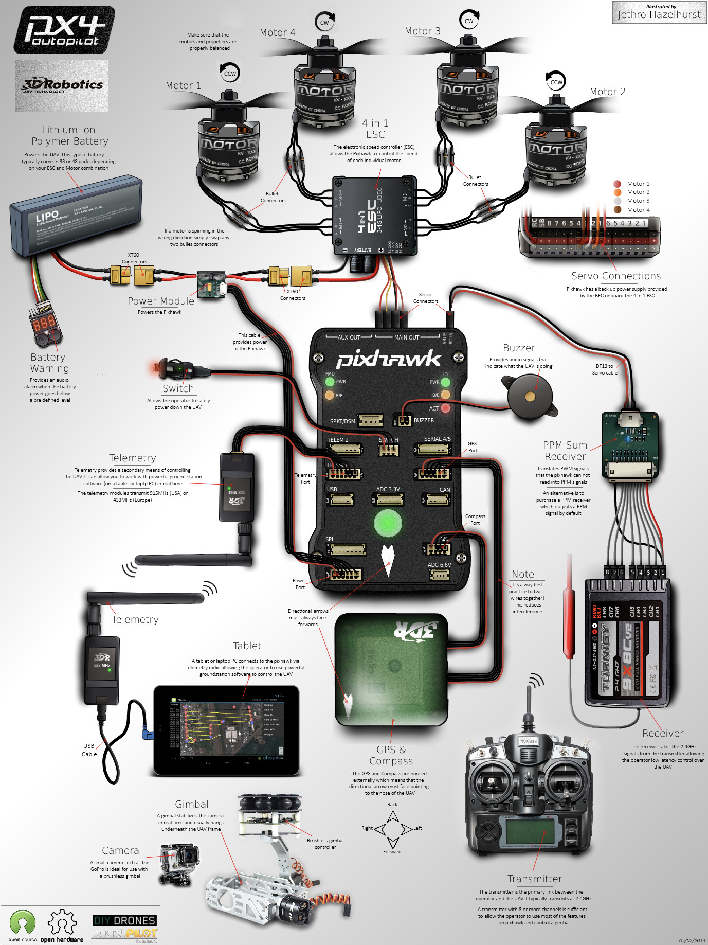
Drone Application
DIY drone with pixhawk flight controller & an on-board Raspberry Pi 3B
most commercial drones are expensive and closed-source
Mapping required between velocity vectors & roll, pitch, yaw angles
derivation covered in [4]
euler angles vs. quaternion [5]
both provided by DroneKit API

Slide 11
Further Work
More Programmability in terms of the shape of the motion profiles
more waveforms
allow asymmetry, maybe allow user to set the ratio of acceleration, constant, deceleration phases
allow velocity profiles with non-zero endpoints
Performance Optimization (currently with Cython)
Implementation with C
Support for more edge devices
Integration with local path planning

Slide 12
Questions
Thank you!

Slide 13
References
"Trapezoidal vs S-Curve Profiles," YouTube, Mar 19, 2013.
Hompson, Peter M, (5 May 2011), "Snap, Crackle, and Pop," AIAA Info, Hawthorne, California: Systems Technology.
Kim Doang Nguyen, I-Ming Chen and Teck-Chew Ng, "Planning algorithms for s- curve trajectories," 2007 IEEE/ASME international conference on advanced intelligent mechatronics, Zurich, 2007, pp. 1-6.
Mellinger, Daniel Warren, "Trajectory Generation and Control for Quadrotors" (2012). Publicly Accessible Penn Dissertations. 547.
Kuffner, James, (2004), "Effective sampling and distance metrics for 3D rigid body path planning," Proceedings - IEEE International Conference on Robotics and Au- tomation, 2004, 3993 - 3998 Vol.4.

